Slide 1

ROBOTIC VEHICLE CONTROLLED BY VOICE COMMANDS
by Arda Mantaş
Faculty of Engineering
Department of Electrical and Electronics Engineering
Istanbul, 2019

Slide 2
1) Wireless Communication
Wireless communication is transfer the data or information from one place to another. The information or data is transmitted from well-defined channels from several meters to hundreds of kilometers.
Wireless communication is diversified according to the transmission distance of information or data. Wireless communication technologies are diversified as follows;
• Satellite communication
• Global Positioning System
• Radio Frequency Identification
• Cellular Communication
• Radio and Television Broadcasting
• Radar Communication
• Wi-Fi
• Bluetooth

Slide 3
- Bluetooth Communication
In this project, communication with bluetooth module was chosen due to the fact that the transmission distance is within the desired value range and that it is cost-effective.
Bluetooth is a short-range wireless technology that enables devices such as computers and mobile phones to transmit data or voice wirelessly over a short distance.
- Masters, Slaves and Piconets
Bluetooth networks (commonly referred to as piconets) use a master/slave model to control when and where devices can send data. In this model, a single master device can be connected to up to seven different slave devices. Any slave device in the piconet can only be connected to a single master.

Slide 4
- What is Piconet?
A piconet is a network of devices connected using Bluetooth technology. The network ranges from two to eight connected devices. When a network is established, one device takes the role of the master while all the other devices act as slaves. Piconet gets its name from the word "pico", which means very small. This very small network is so called because the number is limited to seven devices, plus the master, which limits network and data sharing capability. Data transfer rates vary from 200 to 2,100 kbps at the application. A piconet is sometimes called a personal area network (PAN) because the range of optimal operation for Bluetooth is 10 meters, about the size of a living room.

Slide 5
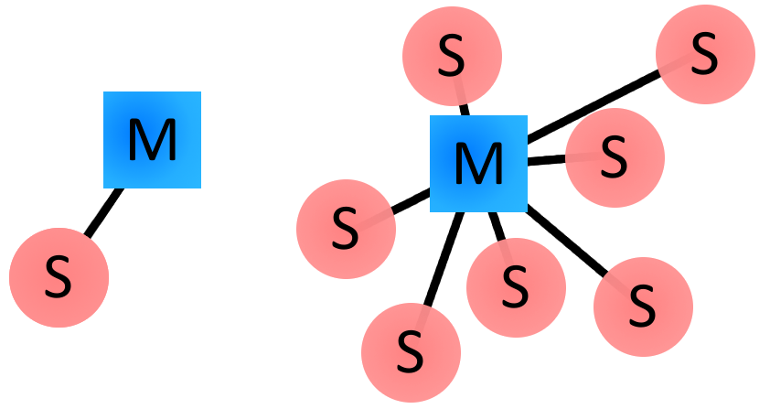
Examples of Bluetooth master/slave piconet topologies

Slide 6
- Advantages & Disadvantages of Bluetooth Communication
Bluetooth communication avoids interference from other wireless devices. Bluetooth is a technology that is open to development and easy to use. Also low energy consumption, very low-cost products according to the performance offers quite attractive options. Thanks to high encryption methods, it has an extremely robust security mechanism and network. Bluetooth brings independence in office and home solutions. Ends the cable dependence in case of travel or movement.
On the other hand, the range is shorter than other types of wireless communications, up to about 30 feet, in addition to the room walls, floors and ceilings can cause a significant reduction in signal quality and range. Pairing can be difficult depending on the device type when attempting to connect.

Slide 7
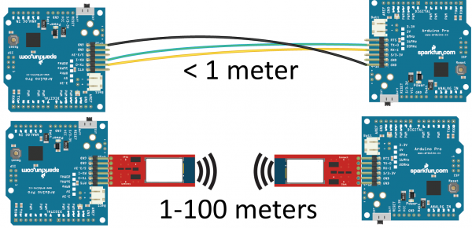

Slide 8
- Connection Process
Inquiry -- If two Bluetooth devices know absolutely nothing about each other, one must run an inquiry to try to discover the other. One device sends out the inquiry request, and any device listening for such a request will respond with its address, and possibly its name and other information.
Paging (Connecting) -- Paging is the process of forming a connection between two Bluetooth devices. Before this connection can be initiated, each device needs to know the address of the other (found in the inquiry process).
Connection -- After a device has completed the paging process, it enters the connection state. While connected, a device can either be actively participating or it can be put into a low power sleep mode.

Slide 9
Active Mode -- This is the regular connected mode, where the device is actively transmitting or receiving data.
Sniff Mode -- This is a power-saving mode, where the device is less active. It'll sleep and only listen for transmissions at a set interval (e.g. every 100ms).
Hold Mode -- Hold mode is a temporary, power-saving mode where a device sleeps for a defined period and then returns back to active mode when that interval has passed. The master can command a slave device to hold.
Park Mode -- Park is the deepest of sleep modes. A master can command a slave to "park", and that slave will become inactive until the master tells it to wake back up.

Slide 10
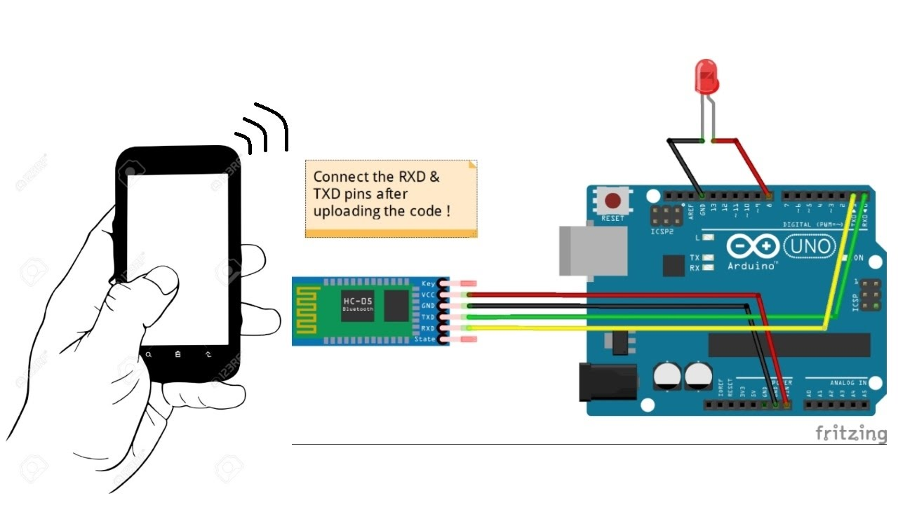

Slide 11
2) Components used in the project
Arduino Mega 2560 Card
Leds
Jumper Wire
Breadboard
HC-SR04 Ultrasonic Distance Sensor
HC-05 Bluetooth Module
DC Gearbox Motor
Buzzer
L298N Motor Driver

Slide 12
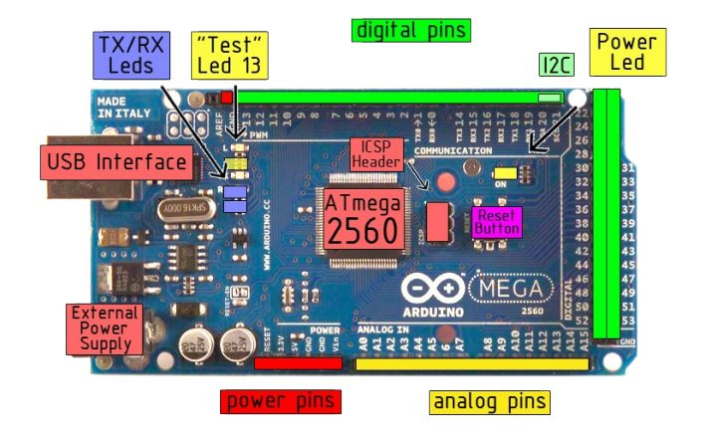
Arduino Mega 2560 Card
The Arduino Mega 2560 is a microcontroller board which is contains 54 digital input / output pins (14 of them can be used as PWM output), 16 analog inputs, 4 UART (hardware serial port), 16 MHz crystal oscillator, one USB connection, a power input, an ICSP header and a reset button.

Slide 13
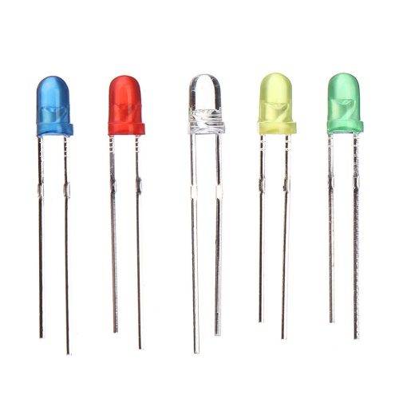
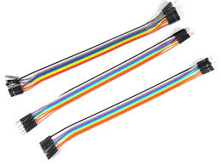
Leds
LED, as a word - consists of the initials of the Light Emitting Diode. Led is a semi-conductive circuit element which is converting electrical energy into light.
Jumper Wire
In short, some kind of connection cables. To make a connection between breadboard and arduino is quite useful. According to the male and female inputs at the ends of it. Also there are 3 types of jumper cables as follows;
Male-Male
Male-Female
Female-Female

Slide 14
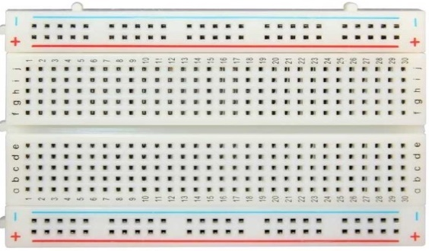
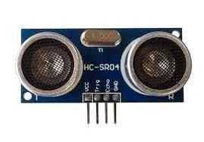
Breadboard
It is the tool that enables to establish circuit with parts without soldering. Breadboard allows the user to test easily. In this way, an error which is possible to observe whether or not by checking the circuit connections.
HC-SR04 Ultrasonic Distance Sensor
HC-SR04 ultrasonic sensor is an input source that calculates the distance from the object to the another object by using sonar (Sound Navigation and Ranging).

Slide 15
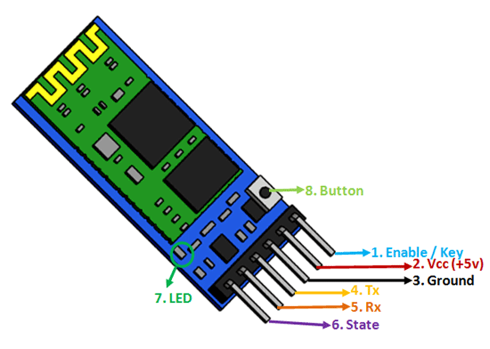
HC-05 Bluetooth Module
HC-05 Bluetooth module can be used as master and slave. In other words, it can receive serial data and also transmit them. Communication is provided by the Rx (Receiver) and Tx (Transmitter) pins on it.
As mentioned in bluetooth communication part, it would not be wrong to say that it is one of the most important component of the project.

Slide 16
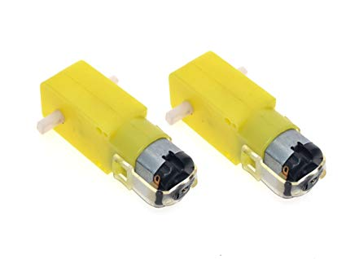
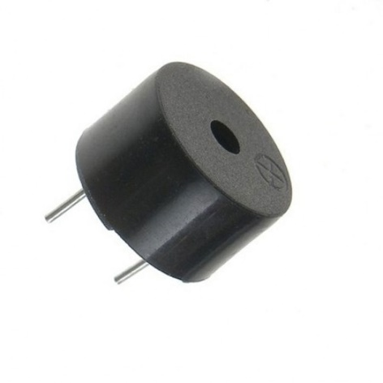
DC Gearbox Motor
The dc motor is the part that gives the wheels the power required to arouse the vehicle.
Buzzer
This circuit element can be considered as a speaker. For example, when turn right command is given, if there is an obstacle on the right side of the device, it will beep and notify the user that it cannot perform the command which is turn right.

Slide 17
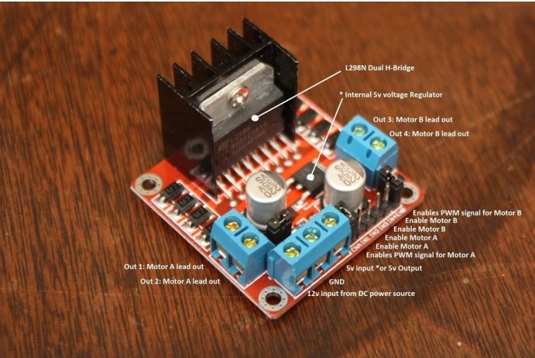
L298N Motor Driver
‘L298N Stepper Motor Driver’ is a DC motor driver board designed to drive two motors between 4.8V-46V. L298N motor driver integrated on the card is used for sumo, mini sumo, line following and variety robot motor control applications. It can supply 2A current per channel which are two separate motors. There are high-temperature and short circuit protection. The board has an internal cooler as well.

Slide 18
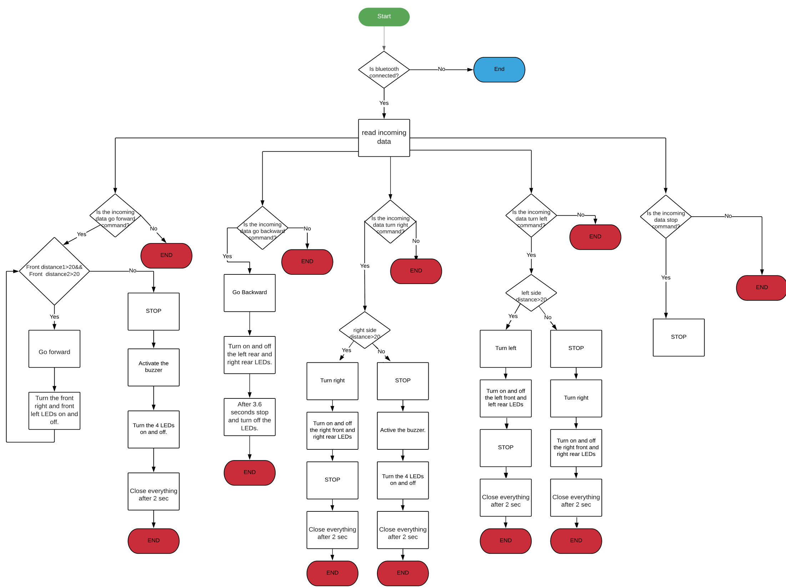
3)Flowchart of the code

Slide 19
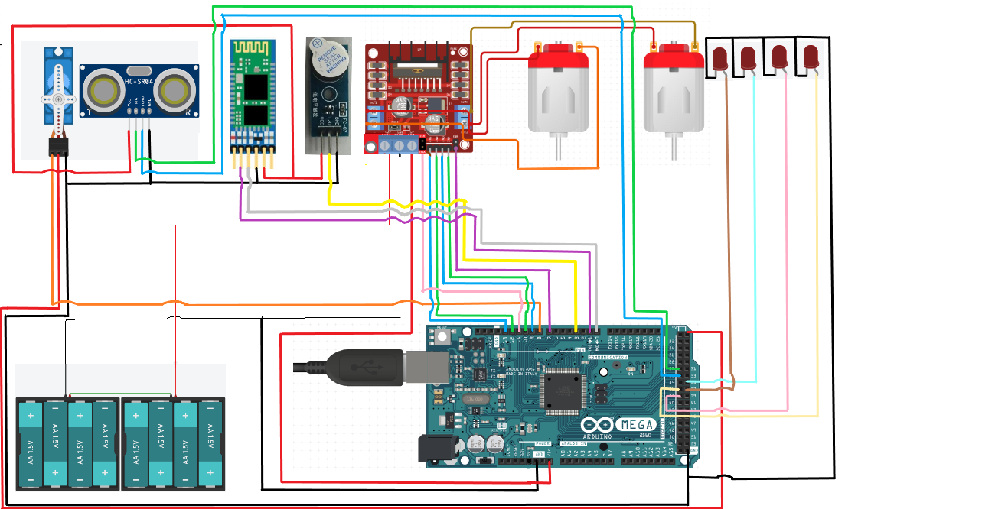
4) Wiring

Slide 20
5) Conclusion
In conclusion, as mentioned earlier the purpose of this project is to create a robot which is driven by voice commands. The project basically consists of two steps: coding and wiring. By the identification of the pins in the code, the commands sent are detected and executed by the robot.
In wiring, the input and output pins must be correctly connected. With enable pins, the speed of the robot's motors can be changed. The required values ​​must be given to these pins in order to rotate the robot at the desired angle according to the command given. The sewing method can be used to avoid cable tangling. The required total voltage value for the parts to operate is provided by the voltage supply.

Slide 21
With the help of the application, voice commands are converted into text and transmitted to the bluetooth module. These text commands must match the commands in the arduino software language.
In this project there are 5 voice commands. These are forward, backward, right, left and stop commands. The ultrasonic sensor according to the direction of the command, it detects and measures the distance to the obstacle. If the measured distance is more than the specified distance with the code, the robot executes the command. On the other hand, if the distance is less than the specified distance, the buzzer runs and therobot does not move.

Slide 22
6) References
https://www.lucidchart.com/documents/edit/b47bfca6-ebca-430e-9d84-6ba805df7a6a/0_0?beaconFlowId=CDF08A566DA5B183
https://www.techopedia.com/definition/5081/piconet
https://learn.sparkfun.com/tutorials/bluetooth-basics/all
A.Mantaş ‘’Robotic Vehicle Controlled by Voice Commands’’ December 2019.

